Slide 1
Week 10/9

Slide 2
Timeline
Mon
Tues
Wends
Fri-Sun
Team meeting with Dr. Ravikumar
Self-Work
Team meetings with TA and team work time
Self-Work
Past Week

Slide 3
VM Requirements
Operating System: Ubuntu, Windows 10, Kali
RAM: 16 GB
Storage: 50 GB (for ubuntu and Kali), 100 GB (Windows 10 requires a lot of operation space)
Architecture:
2 testing VMs per team member: 6 ubuntu, 6 windows
1 master set of VMs for the team, 1 ubuntu, 1 windows
1 Kali (at least. Maybe a Kali Purple VM too for defense?)
Possibly 1 Kali Purple
16 total VMs: 7 ubuntu, 7 windows, 2 kali
4 Security onion virtual machines
Programs/downloadables we’ll be using:
Helics, pandapower, opendss, visual studio, git, python
NOTE FOR THE FUTURE: Security Onion requires 8 GB of RAM and 200 GB of free space so we will need those requirements in the future for both a Management node and a Search node. Instead of creating forward nodes on the other machines we can just have those machines forward their logs without installing a forward node (rsyslog for Ubuntu, will need to find another solution for Windows.

Slide 4
Recap & Feedback
Met with Dr. Gelli Ravikumar and discussed using Docker and getting OpenDSS to work with OpenDER
Met with our TA to discuss next week’s assignments:
Project plan assignment and lightning talk

Slide 5
Overview of Work
Explore CyHELICS, pandapower, and OpenDSS
Created Project Plan Lightning talk

Slide 6
Actual Work
Met as a group to review last week’s advisor meeting
Talked over the Project Plan lightning talk and upcoming plans
Started exploring using Docker with Helics and Pandapower
Talked over possible power grid designs and OpenDSS
Talked more over the broad scope of the project and what we want to focus on this semester
Messed with Security Onion a little more - Tyler (didn’t have time for much outside of the lightning talk)

Slide 7
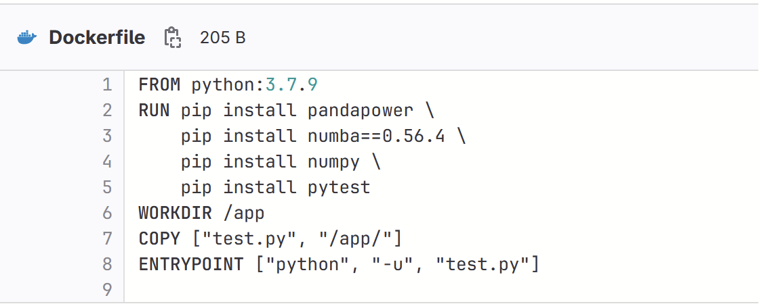
Actual Work - Justin
Worked a lot with the Docker files that will be used to compile our code.

Slide 8
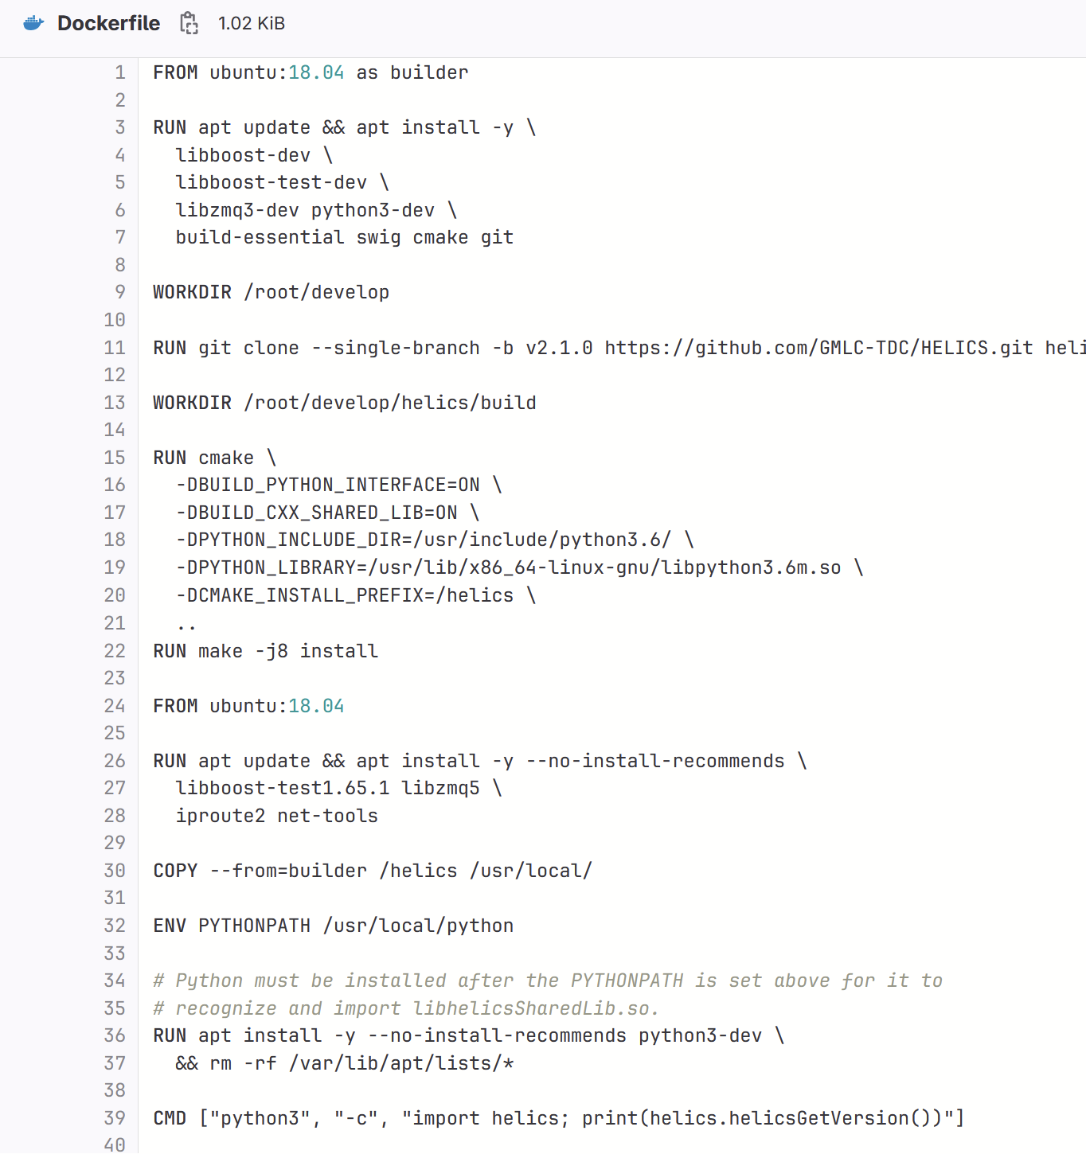

Slide 9
Work - Zach
Continued Testing PandaPower with more complex examples
Using matplotlib to plot networks
Working with different data structures
Started Testing HELICS examples found on their github
TODO:
Understand the connection between pandapower and HELICS

Slide 10
Actual Work - Tommy
PandaPower:
Began to read through tutorials given by the developers to try to have a basis for when we create and simulate our grid
Read through the basic introduction tutorials including
Minimal example
Showed the coding on how to create a very basic power system and the values from different analyses
Creating a simple network
Tutorial for the user to understand the pandapower datastructure and how to create networks through the pandapower API
Showed code, a physical representation of what the code was creating, and how to confirm your creations were successful by checking various tables
Running a power flow
Imports previously made model, then shows various analysis codes and tables on different part of the model and equipment values
Creating an advanced network
Much more in depth model and the code to create it. Included residential loads, various voltage levels, generation components, external grid incorporation, etc.

Slide 11
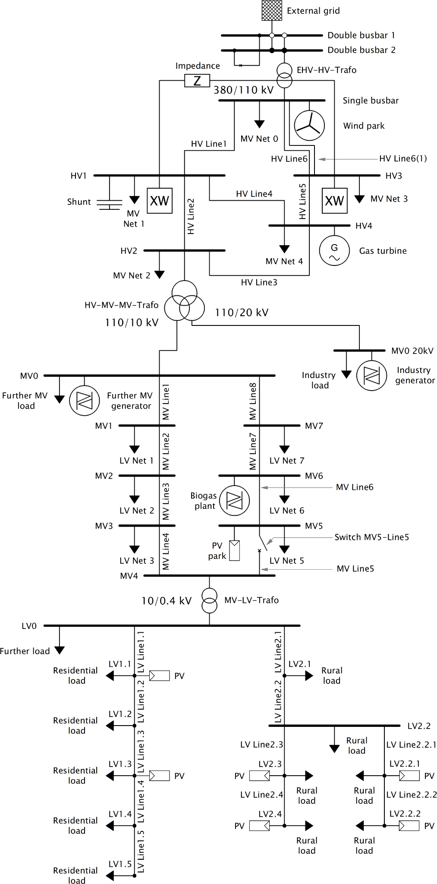
Actual Work - Tommy
Spent most of my time exploring the advanced example pictured on the right

Slide 12
Work - Matt
OpenDER:
Version 2.0 (current) includes photovoltaic (PV) and battery energy storage system (BESS) DER behaviors according to the capabilities and functionalities required by the IEEE standard 1547-2018.
This project is licensed under the terms of the BSD-3 clause license.
Runs with Python
Looked through an example posted on GitHub that models a 1-1.10 pu voltage every 10 minutes
Can model BESS and graph the stabilization of the power factor from the DER
Can model the DER output power
Can model the state of charge (SOC) and load capabilities of a BESS model
I wasn't able to find anything specifically referencing the integration of OpenDER with OpenDSS, but both use python and developed by EPRI (Electric Power Research Institute).

Slide 13
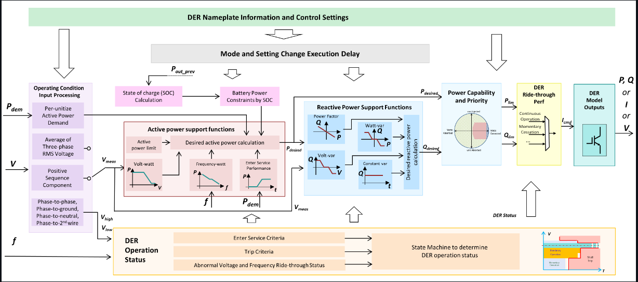
Work - Matt

Slide 14
Work - Kaya
Project plan lightening presentation
Created the slides on Wednesday, recorded on Saturday
Docker
Went through the Docker getting started and read through some of the manual pages
Py_DSS
Went through the getting started/experiment

Slide 15
Next Week's Plan
Get access to, and set up the VMs
Installing Helics, pandapower, openDSS, git, visual studio so this box can be copied out for all members
Mess with OpenDSS, OpenDER, Py_DSS and Pandapower some more (and Security Onion)

